Slide 1
UNIT 8 : SPORTS AND GAMES
Lesson 1 : Getting started-At the gym.

Slide 2
* Vocabulary:
Congratulation
(n) /kənˌgræt.jʊˈleɪ.ʃən/:
Xin chúc mừng
Gym
(n) /'dʒim/:
Phòng tập thể hình
Đấm bốc, quyền anh
- table tennis
(n) teibl tenis /
Bóng bàn
- karate
kəˈraːti/
Võ Ka-ra-te
- skiing
(n) /ˈskiː.ɪŋ/
Trượt tuyết
-volleyball
(n) /ˈvɒl.i.bɔːl/
Bóng chuyền
-tennis (n)
/ˈtenɪs/
Quần vợt

Slide 3
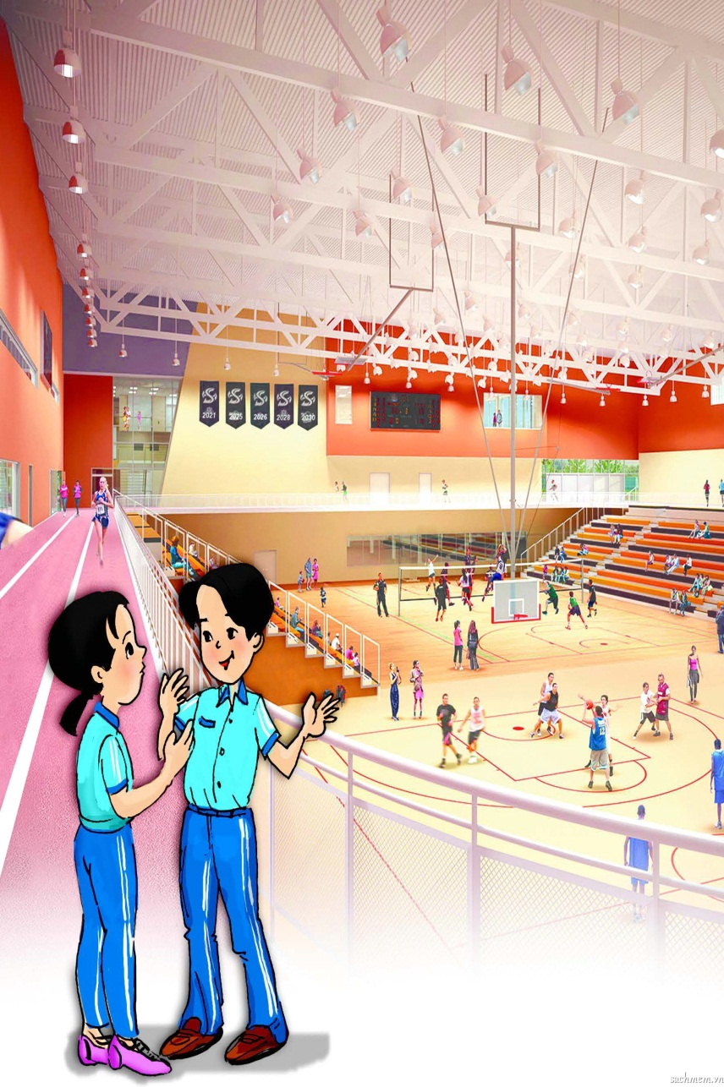
At the gym
Duong: Wow! This gym is great!
Mai: Yeah, I really like coming here. The equipment is modern and the people are friendly. What sports do you do, Duong?
Duong: Well, I can do a little karate, and I play table tennis. Last week I played with Duy and I won for the first time.
Mai: Congratulations! How often do you do karate?
Duong: Every Saturday.
Mai: You’re very fit! I’m not good at many sports.
Duong: I have an idea. You can come to the karate club with me.
Mai: No, I can’t do karate.
Duong: But you can learn! Will you come with me on Saturday?
Mai: Well.... OK.
Duong: Great! I’ll meet you at the club at 10 a.m.
Mai: Sure. Where is it? How do I get there?
Duong: It’s Superfit Club, on Pham Van Dong Road. Take Bus 16 and get off at Hoa Binh Park. It’s 15 minutes from your house.
Mai: OK. See you then.

Slide 4
1. What sports can Duong do?
Duong can play table tennis and do karate.
2.Who is going to learn karate?
Mai is going to learn karate. / Mai is.
3.Why does Mai like going to the gym?
Because the equipment there is modern and the people are friendly. / Because the equipment is modern and the people are friendly.
4.What happened last week?
Duong played with Duy and won for the first time. / Duong played with Duy and won.
5.Where are they going to meet on Saturday?
At the karate club.

Slide 5
1. Wow!
2. Congratulations!
3. Great!
4. See you (then).
used to express surprise
used to congratulate somebody.
used to show admiration
used when you say goodbye

Slide 6
boxing
fishing
aerobics
chess
table tennis
karate
cycling
swimming
volleyball
tennis
skiing
running

Slide 7
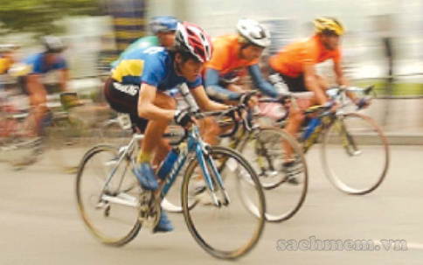
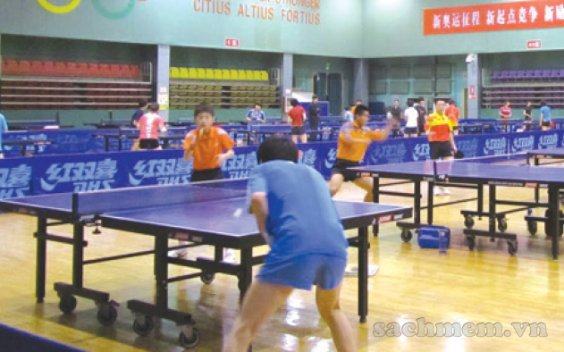
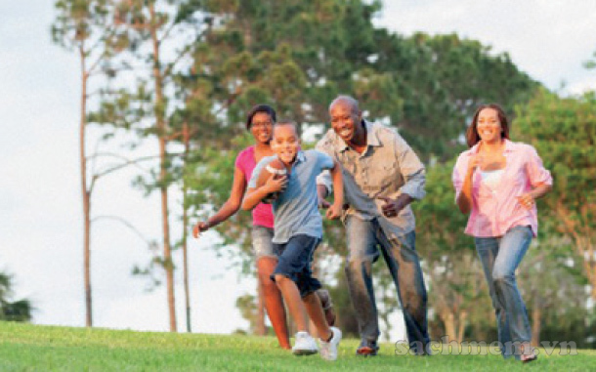
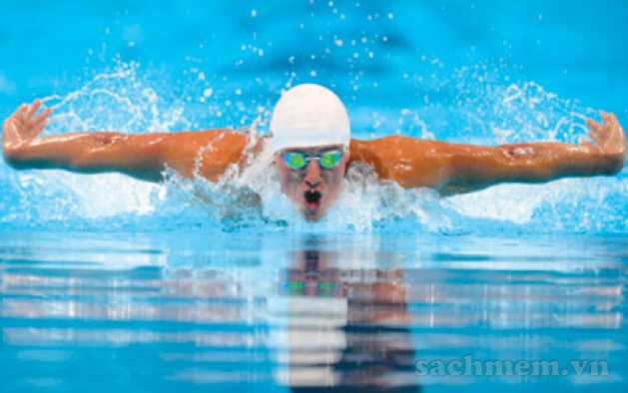
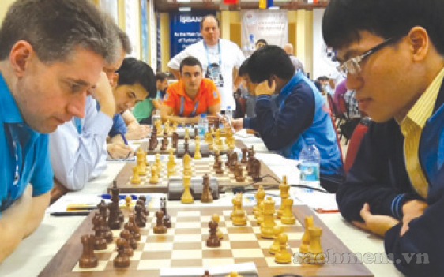
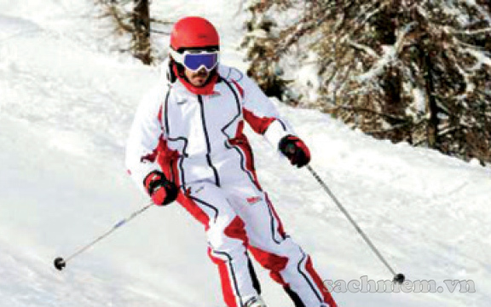
1. .
2. .
3. .
5. .
6. .
4. .

Slide 8
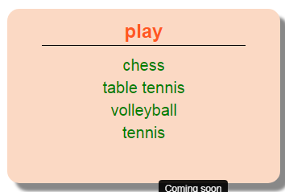
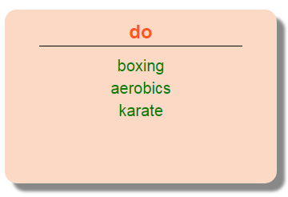
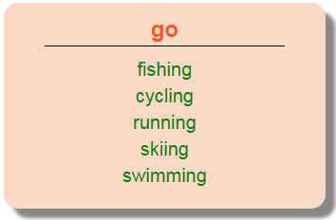

Slide 9
1. Duong can karate.
2.Duy is not reading now. He a game of tennis on TV.
3.Michael swimming nearly every day.
4.Phong doesn’t play football. He reading books.
5.Khang volleyball last Saturday evening.
do
is watching
go
likes
played

Slide 10
Thank you. See you
again!!!

